Slide 1


Using AI To Develop A Working Delphi Multi-Device Application
David Intersimone “David I” david.intersimone@gmail.com

Slide 2
Agenda
About David I
LLMs for Coding
My Process for this Talk
Started with a Simple Prompt
Demos
Lessons Learned
Summary
Q&A

Slide 3
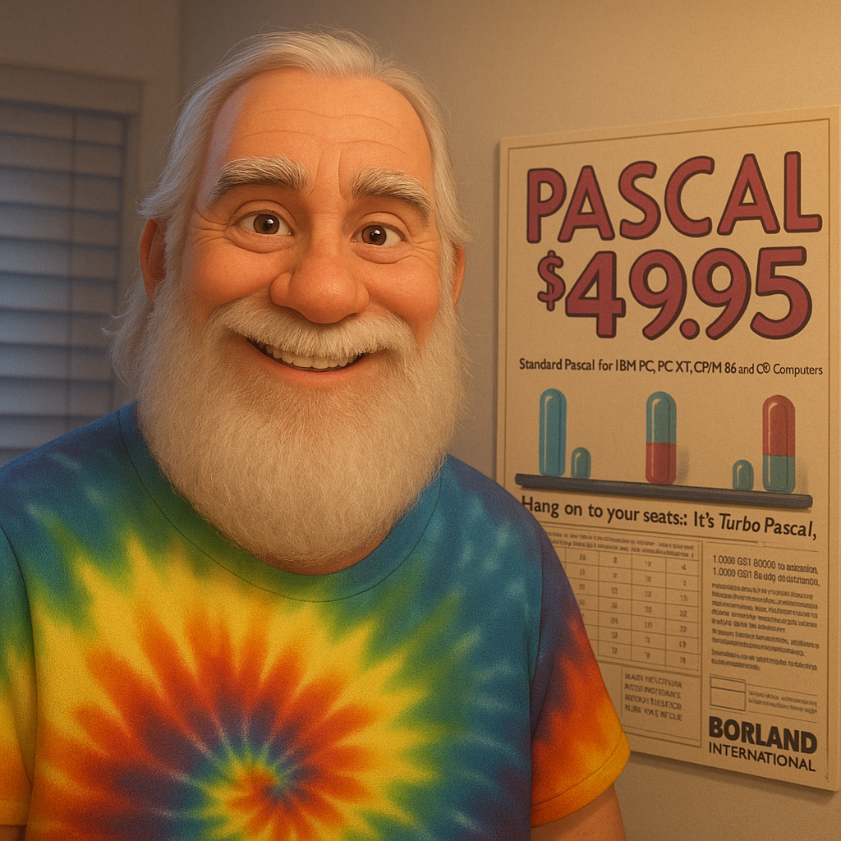
About David I
Wrote first program in September 1969 – Fortran prime number generator
Software Engineer for 52+ years
Worked at Borland/Inprise/CodeGear/Embarcadero for 32 years
Embarcadero MVP
Still using Delphi and C++Builder every day
Blogs:
https://blogs.embarcadero.com/author/davidi/
https://blog.davidi.com/
Social:
LinkedIn - https://www.linkedin.com/in/davidi99/
X - https://x.com/davidi99
Email: david.intersimone@gmail.com

Slide 4
LLMs for Coding
OpenAI GPT-5 / GPT-5-Codex
Anthropic Claude 3.5 Sonnet / Claude 4.x Sonnet with Claude Code
Google Gemini 2.5 Pro
Meta Llama 3.1 405B Instruct
DeepSeek-V2.5-1210 (with DeepSeek-V3 as the successor)
Alibaba Qwen2.5-Coder-32B-Instruct
Mistral Codestral 25.01
Source:
https://www.marktechpost.com/2025/11/04/comparing-the-top-7-large-language-models-llms-systems-for-coding-in-2025/
Updates:
GPT 5.1 - November 2025
Gemini 3 - November 2025
Claude Sonnet 4.5 - September 2025

Slide 5
My Process for this Talk
My plan
Learning to build multi-device apps
LLM(s) do all the work - creation, updates and fixes
Record/Report all of the interactions, issues, progress
Use ChatGPT 5, Claude Sonnet 4.5, Gemini 3
My General use of “modern” AI
IDE for Code Completion, Features, Modernization
Create Prototypes and Explorations
Integrate AI functionality SDKs

Slide 6
Started with a Simple Prompt
“Use Delphi 13 and FireMonkey FMX to create multi-device futuristic text adventure application that features a tour through the solar system planets, moons and major asteroids”
Then “vibe” with the flow

Slide 7
Demos
ChatGPT 5
Claude Sonnet 4.5
Gemini 3

Slide 8
Lessons Learned
Use as much specificity in prompts up front to avoid mistakes
Tools continue to improve, evolve, appear, disappear
Check support for languages, libraries, frameworks, architectures and platforms
Benchmark scores don't predict production code completeness
Leverage IDE/tool integration, components and automation

Slide 9
Summary
ChatGPT 5 – offered app features, helped with error & exceptions, working app
Claude Sonnet 4.5 – created simple app, UI took time to prompt tune
Gemini 3 – created project and separated UI from engine, no project zip download

Slide 10
Thank You!
Q&A
Code, Slides, Documents on GitHub
https://github.com/davidi99/SolarSystemTextAdventure

